Slide 1
Arrays

Slide 2
Arrays
Java provides a data structure, the array, which stores a fixed-size sequential collection of elements of the same type.
An array is used to store a collection of data, but it is often more useful to think of an array as a collection of variables of the same type.
Instead of declaring individual variables, such as number0, number1, ..., and number99, you declare one array variable such as numbers and use numbers[0], numbers[1], and ..., numbers[99] to represent individual variables.

Slide 3
Declaring Array Variables
To use an array in a program, you must declare a variable to reference the array, and you must specify the type of array the variable can reference.
Here is the syntax for declaring an array variable
dataType[] arrayRefVar; // preferred way.
or
dataType arrayRefVar[]; // works but not preferred way.

Slide 4
Creating Arrays
You can create an array by using the new operator with the following syntax
arrayRefVar = new dataType[arraySize];
it creates an array using new dataType[arraySize].
It assigns the reference of the newly created array to the variable arrayRefVar.

Slide 5
Creating Arrays
Declaring an array variable, creating an array, and assigning the reference of the array to the variable can be combined in one statement, as shown below
dataType[] arrayRefVar = new dataType[arraySize];
Alternatively you can create arrays as follows
dataType[] arrayRefVar = {value0, value1, ..., valuek};
The array elements are accessed through the index. Array indices are 0-based; that is, they start from 0 to arrayRefVar.length-1.

Slide 6
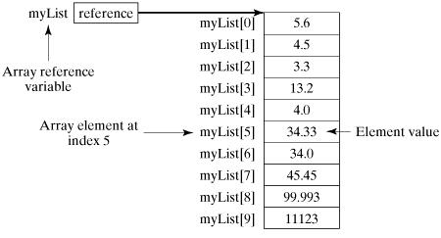
Example
Following statement declares an array variable, myList, creates an array of 10 elements of double type and assigns its reference to myList
double[] myList = new double[10];

Slide 7
Processing Arrays
public class TestArray {
public static void main(String[] args) {
double[] myList = {1.9, 2.9, 3.4, 3.5};
for (int i = 0; i < myList.length; i++) {
System.out.println(myList[i] + " ");
}
double total = 0;
for (int i = 0; i < myList.length; i++) {
total += myList[i];
}
System.out.println("Total is " + total);
// Finding the largest element
double max = myList[0];
for (int i = 1; i < myList.length; i++) {
if (myList[i] > max) max = myList[i];
}
System.out.println("Max is " + max);
}
}

Slide 8
Output
1.9
2.9
3.4
3.5
Total is 11.7
Max is 3.5

Slide 9
The enhanced for Loops
public class TestArray {
public static void main(String[] args) {
double[] myList = {1.9, 2.9, 3.4, 3.5};
// Print all the array elements
for (double element: myList) {
System.out.println(element);
}
}
}

Slide 10
Output
1.9
2.9
3.4
3.5

Slide 11
Passing Arrays to Methods
public static void printArray(int[ ] array) {
for (int i = 0; i < array.length; i++) {
System.out.print(array[i] + " ");
}
}
Can be called as:
printArray(new int[]{3, 1, 2, 6, 4, 2});

Slide 12
Returning an Array from a Method
public static int[] reverse(int[] list) {
int[] result = new int[list.length];
for (int i = 0, j = result.length - 1; i < list.length; i++, j--) {
result[j] = list[i];
}
return result;
}

